Slide 1
R&D Testing

Slide 2
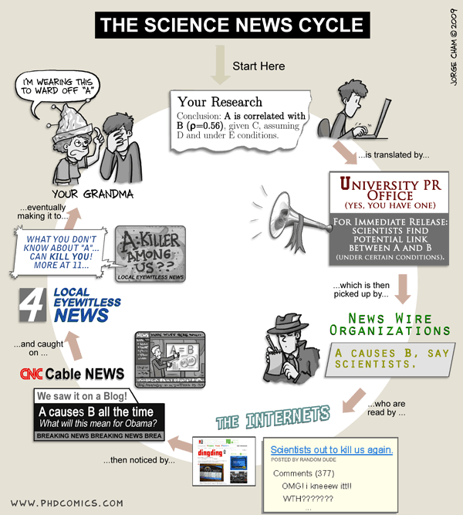
Research
Small increments
Specialized
AI is here to take our jobs

Slide 3
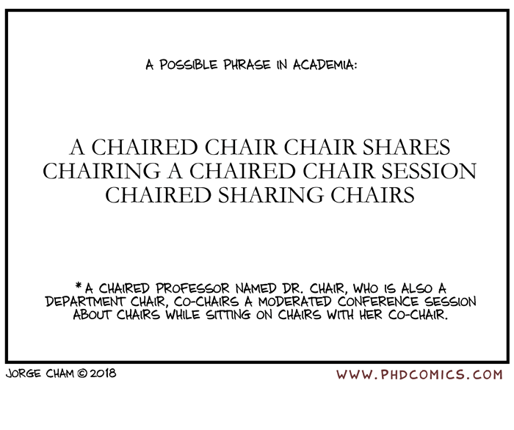
Research topics/what we do
Overcoming the Equivalent Mutant Problem: A Systematic Literature Review and a Comparative Experiment of Second Order Mutation
GenProg: A Generic Method for Automatic Software Repair
A Systematic Literature Review of Software Defect Prediction: Research Trends, Datasets, Methods and Frameworks
Using Natural Language Processing to Automatically Detect Self-Admitted Technical Debt
Automated Checking of Conformance to Requirements Templates Using Natural Language Processing
Text Filtering and Ranking for Security Bug Report Prediction

Slide 4
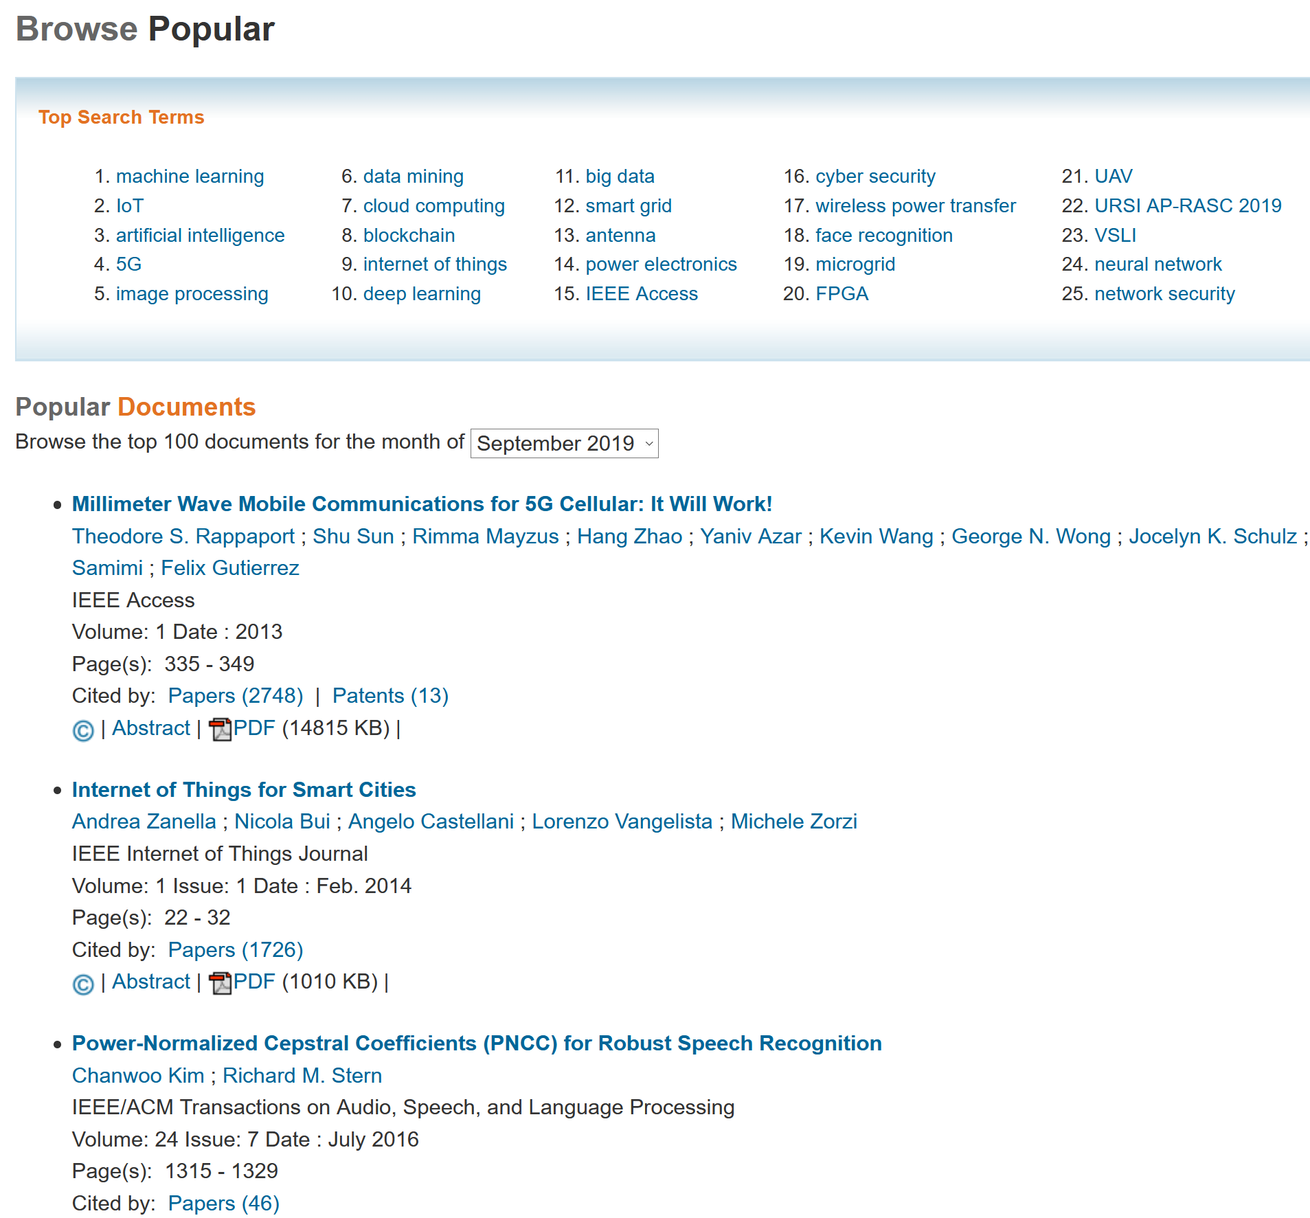
Pop topics

Slide 5
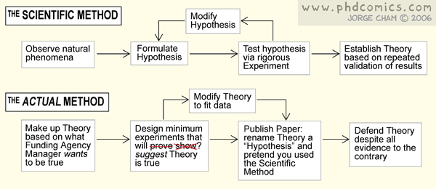
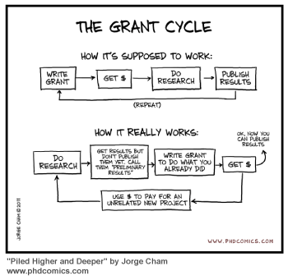
And how we do it

Slide 6
When I can get it?
Test-driven development
12000 BC : OgTheVenerable, holding a raw piece of meat, describes the process of creating fire to his fellow cavemen, setting their expectations and a prescription for his own task. The piece of charred meat he held in his hand afterward is widely regarded as the first passing test case.
1959 through 1963 : programmers for the Mercury Space Program use a form of TDD while programming punched cards
Scrum
Hirotaka TakeuchiIkujiro Nonaka, The New New Product Development Game, Harvard Business Review, January 1986
Well…

Slide 7
Research Trends
Automatic Software Repair
The Oracle Problem in Software Testing
Software Fault Localization
Defect Prediction
Technical Debt
Persistent Software Errors

Slide 8
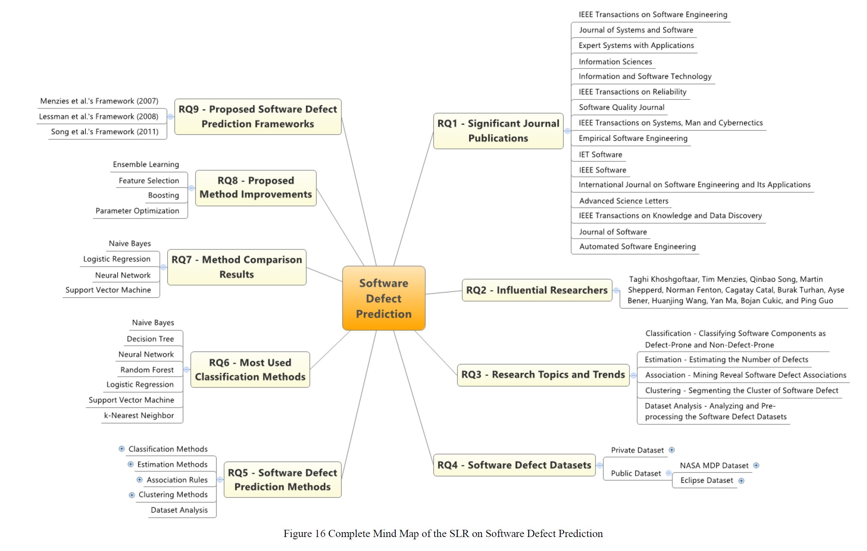
Software Defect Prediction: Research Trends, Datasets, Methods and Frameworks
1. Estimation
2. Association
3. Classification
4. Clustering
5. Dataset Analysis
Notes:
1. Estimating the number of defects remaining in software systems, using the estimation algorithm (Estimation)
2. Discovering defect associations using the association rule algorithm (Association)
3. Classifying the defect-proneness of software modules typically into two classes namely defect-prone and not defect-prone using the classification algorithm (Classification)
4. Clustering the software defect based on object using the clustering algorithm (Clustering)
5. Analyzing and pre-processing the software defect datasets (Dataset Analysis)

Slide 9
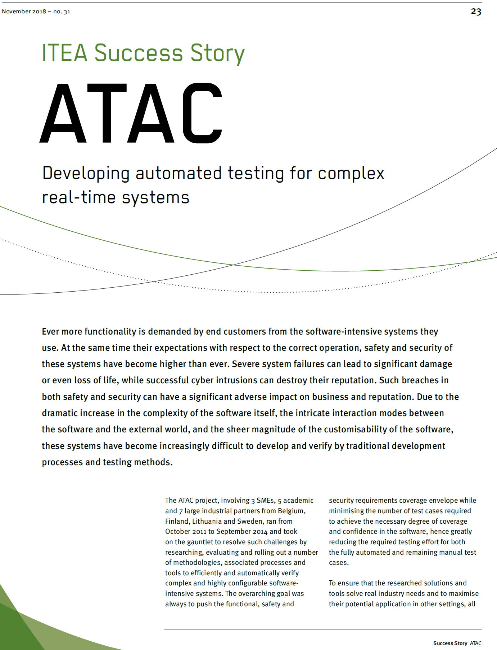
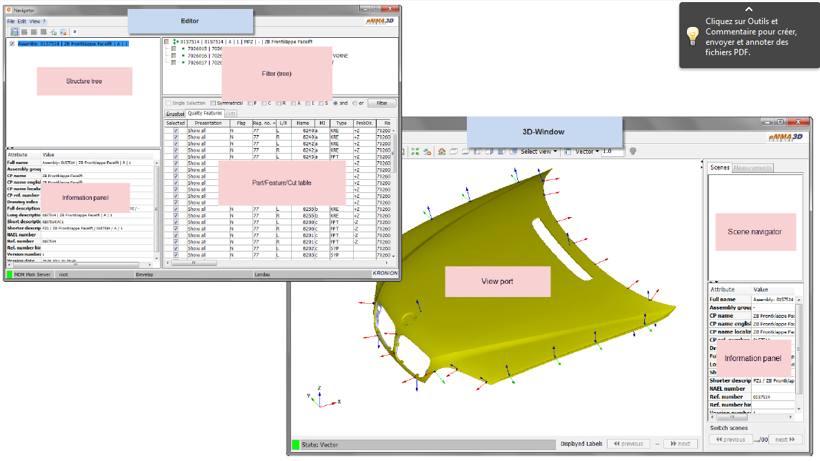
KTU Topics
Model Based Testing
GUI Defect Search
Hardware testing
FPGA, VHDL, ….

Slide 10
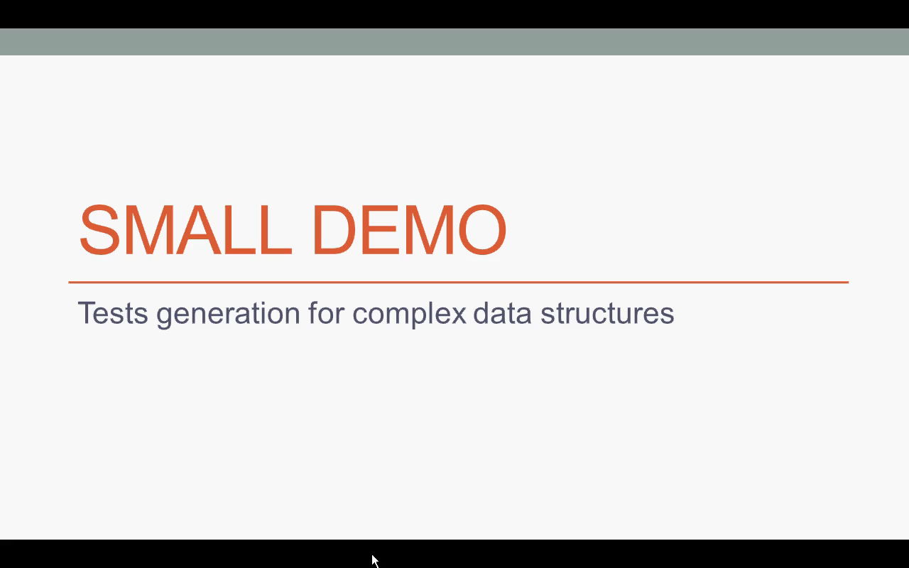
Model Based Testing

Slide 11
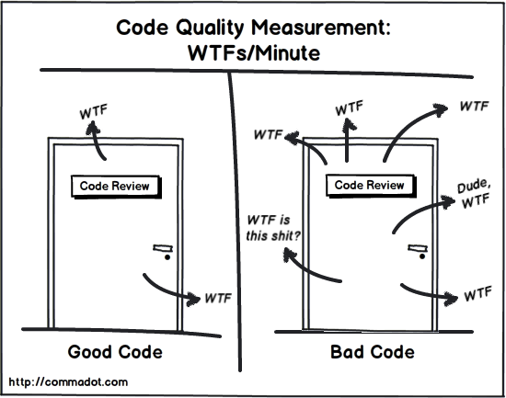
GUI Testing
Have you ever looked at the app at thought: something does not look right here….
Were you able to objectively describe what’s wrong and how should it be?

Slide 12

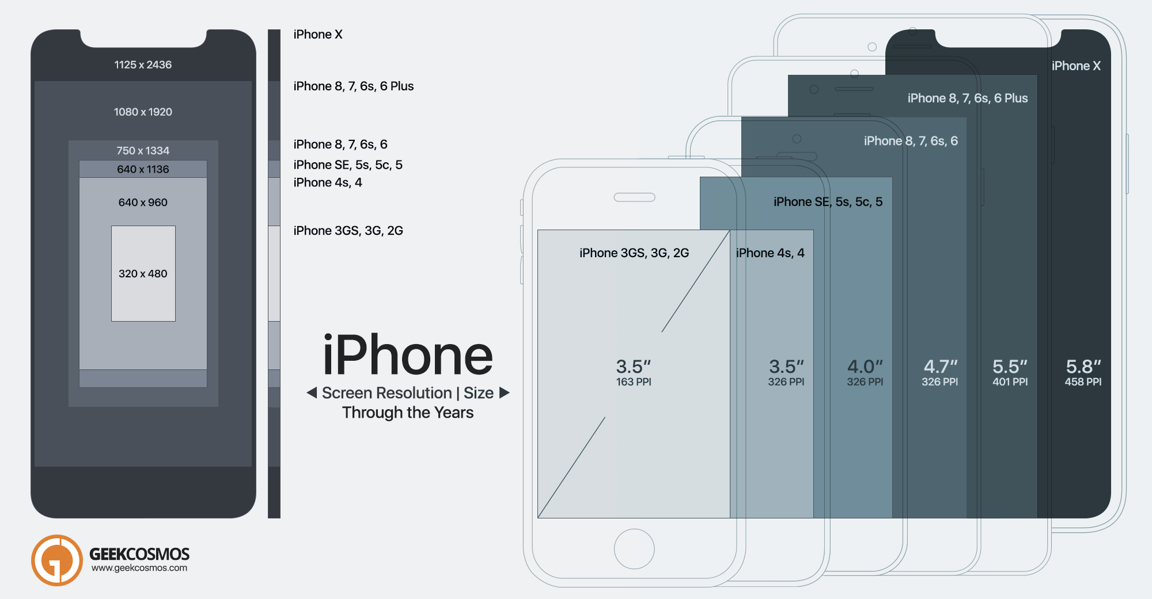
Mobile app “features” - problems
Various device configurations – “well it works on mine, should be ….”
Bad layout, missing, invisible text.
Unreadable texts
Internationalization
Spelling, grammar errors
Automated translation
Poor text style
Messages are not always
“understandable”

Slide 13
User interface defects
Layout problems:
Invisible control
Clipped control
Too small control
Misaligned controls
Text problems:
Too small text
Partial text
Image problems:
Bad scaling
Bad resolution
Colour problems:
Hidden control
Not matching colours
Poor colour choice
Application menu problems:
Menu does not fit to a screen/toolbar
Missing icons.
Navigation problems:
Stuck at screen
Wrong window
App crash
Timing problems

Slide 14
Experiment
Test 1000 apps.
Log defects
Classify defects
Define automated testing method
Define defect detection rules
Run rules on 1000 apps.
Compare results – prove that it’s good.

Slide 15
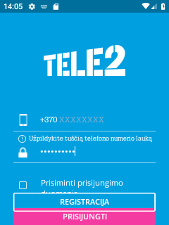
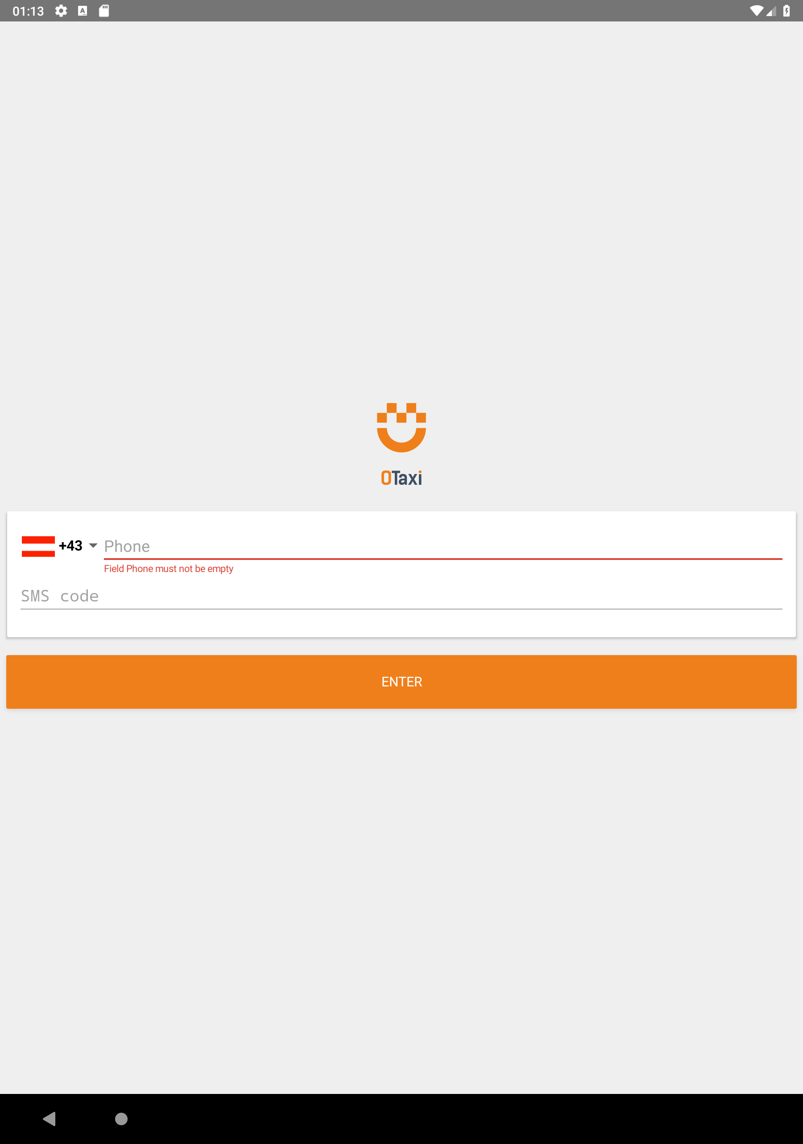
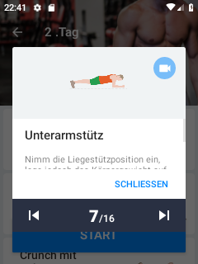
Defects

Slide 16
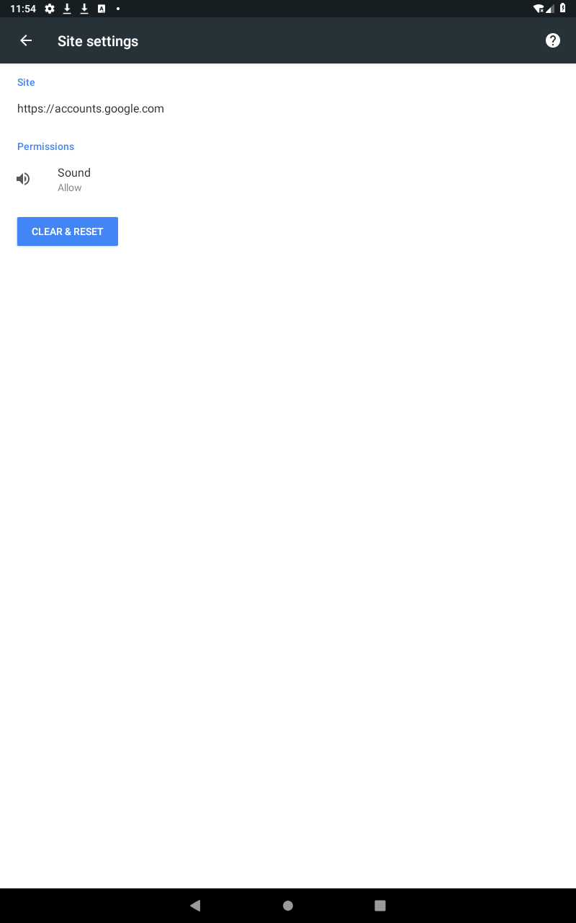
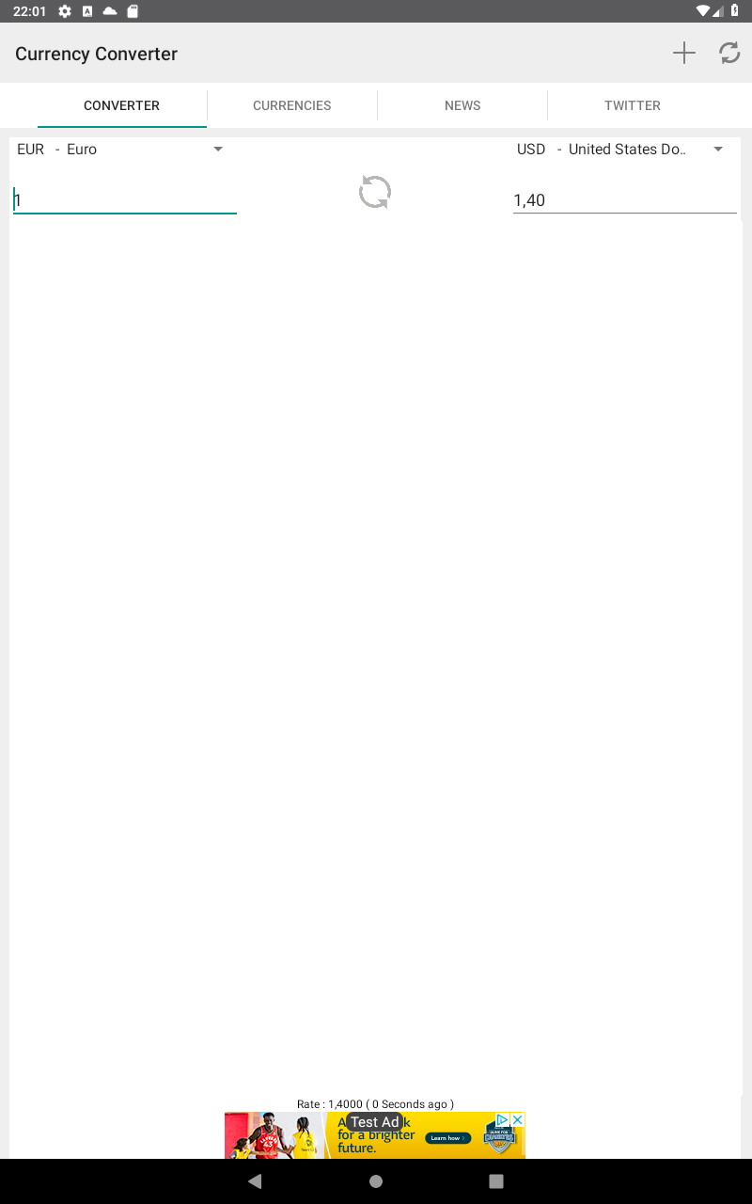
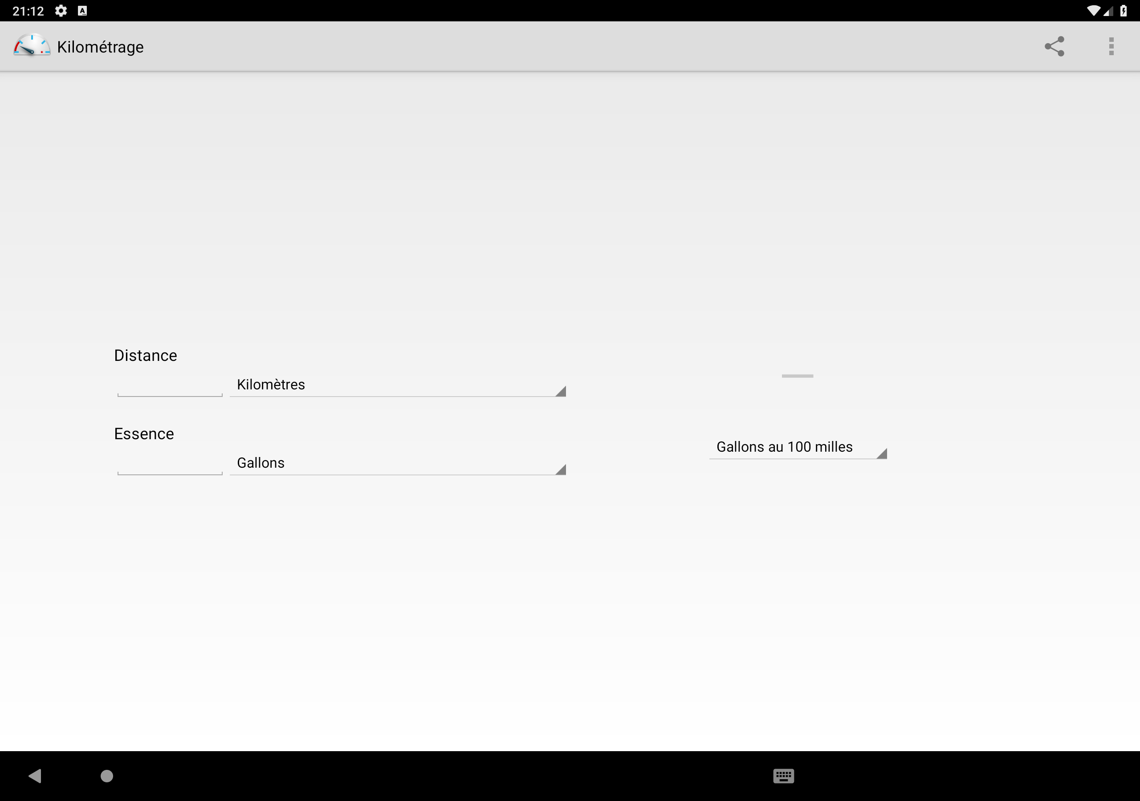
Defects…

Slide 17
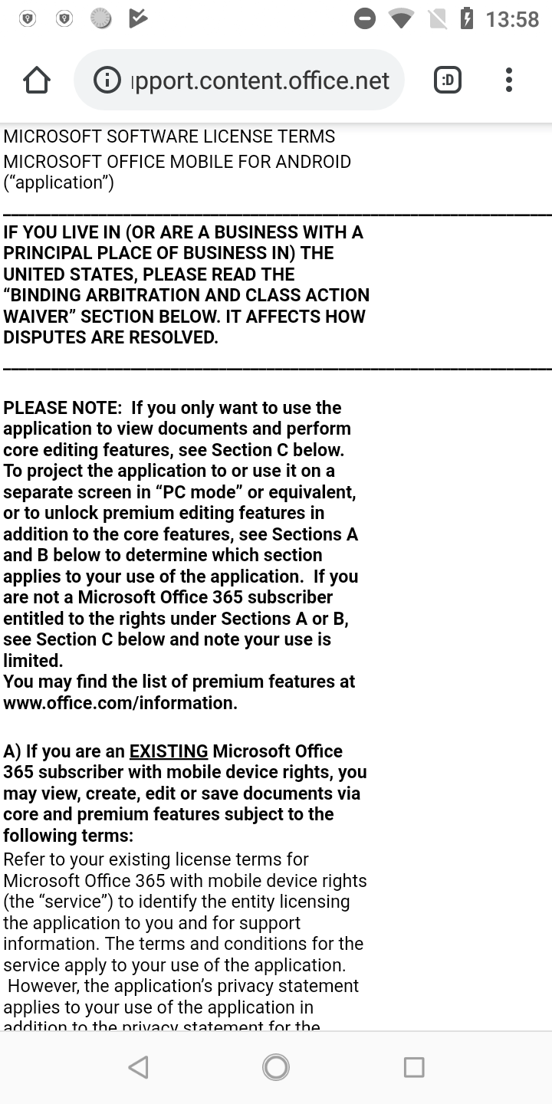
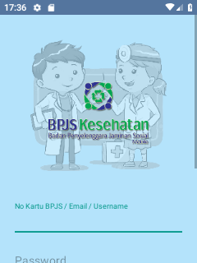
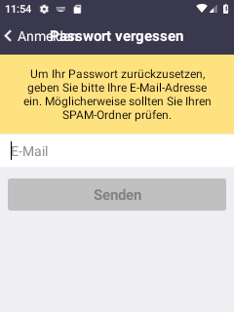
Defects

Slide 18
The proposed method
1. Execute app on many devices.
2 .Take screenshots at each execution step.
3. Search for defects in each screenshot:
Defined defect classes.
Defect detection rules per each class.

Slide 19
Detected Defects Summary
Defect Type | English | Non-English | Phone | Tablet | Small Screen | Normal Screen | Large Screen | Total
Bad Spelling | 1 | 10 | 8 | 3 | 7 | 1 | 3 | 11
Wasted Space | 208 | 2294 | 711 | 1791 | 546 | 83 | 1873 | 2502
Technical Jargon | 260 | 488 | 589 | 159 | 425 | 98 | 225 | 748
Clipped Text | 1842 | 4426 | 5800 | 468 | 4302 | 1035 | 931 | 6268
Wrong Font Sizes | 0 | 91 | 3 | 88 | 3 | 0 | 88 | 91
Untranslated Text | 176 | 1075 | 1059 | 192 | 550 | 469 | 232 | 1251
Bad Colors | 73 | 210 | 192 | 91 | 118 | 50 | 115 | 283
Bad Scaling | 37 | 284 | 150 | 171 | 128 | 12 | 181 | 321
Low Res Image | 8 | 63 | 53 | 18 | 26 | 24 | 21 | 71
Clipped Control | 359 | 1165 | 1303 | 221 | 1105 | 94 | 325 | 1524
No Margins | 120 | 169 | 256 | 33 | 181 | 65 | 43 | 289
Uncentered | 104 | 323 | 323 | 104 | 278 | 35 | 114 | 427
Unfilled Placeholder | 0 | 30 | 21 | 9 | 17 | 4 | 9 | 30
Bad Margins | 194 | 277 | 394 | 77 | 277 | 45 | 149 | 471
Obscured Control | 36 | 159 | 193 | 2 | 183 | 9 | 3 | 195
No Anti Aliasing | 0 | 6 | 6 | 0 | 6 | 0 | 0 | 6
Empty View | 759 | 2274 | 2307 | 726 | 1115 | 899 | 1019 | 3033
Unreadable Text | 19 | 305 | 310 | 14 | 280 | 25 | 19 | 324
Clashing Background | 36 | 101 | 110 | 27 | 64 | 37 | 36 | 137
Unaligned Controls | 92 | 162 | 247 | 7 | 223 | 21 | 10 | 254
Crowded Controlls | 18 | 89 | 105 | 2 | 105 | 0 | 2 | 107
Obscured Text | 115 | 413 | 509 | 19 | 428 | 38 | 62 | 528
Unlabeled Entry Field | 171 | 349 | 399 | 121 | 234 | 86 | 200 | 520
Not Enough Space | 34 | 285 | 257 | 62 | 205 | 45 | 69 | 319
Missing Text | 29 | 33 | 43 | 19 | 29 | 4 | 29 | 62
Wrong Encoding | 0 | 3 | 2 | 1 | 1 | 1 | 1 | 3
Misaligned Control | 0 | 25 | 1 | 24 | 0 | 1 | 24 | 25
Too Large Control | 0 | 2409 | 0 | 2409 | 0 | 0 | 2409 | 2409

Slide 20
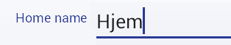
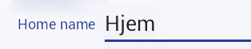
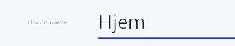

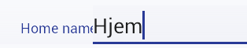
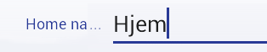
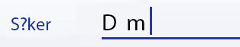
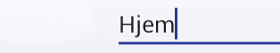
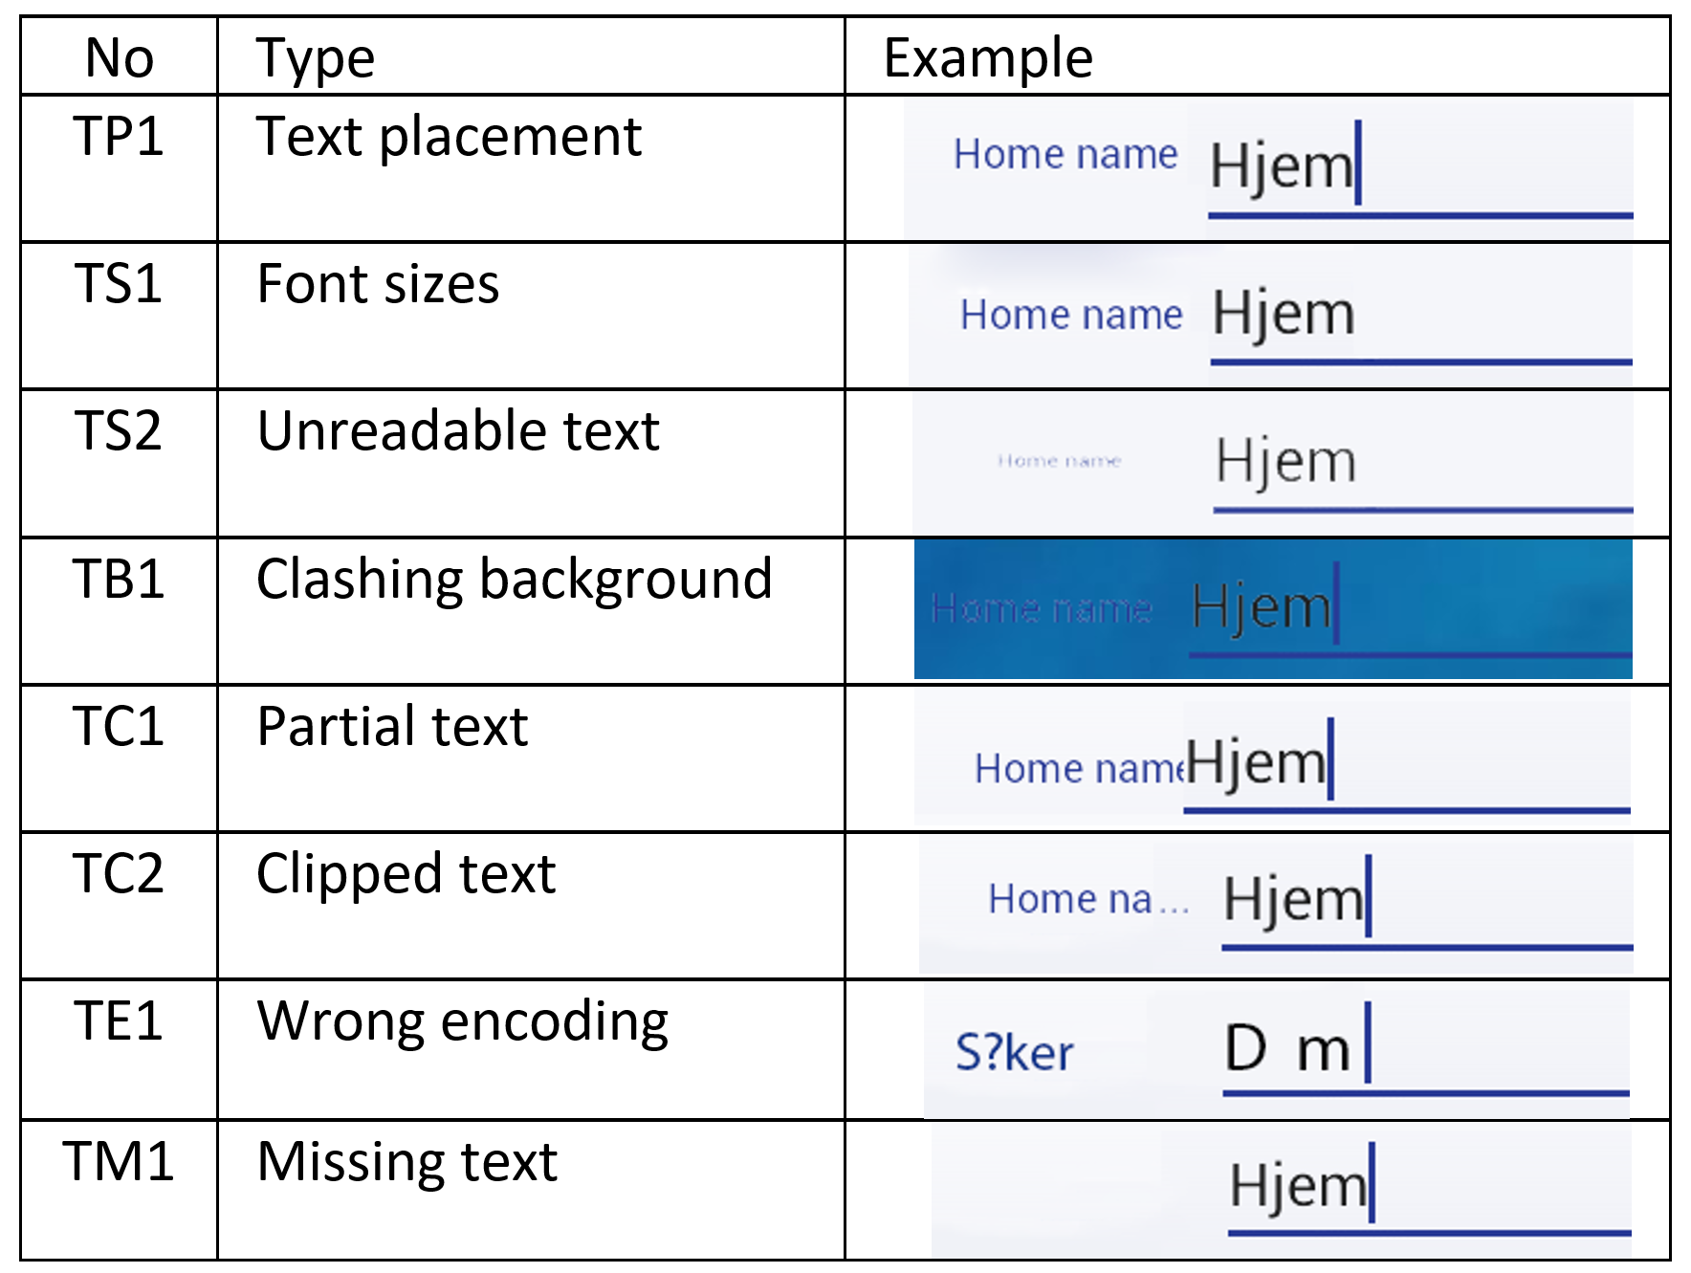
Classification of the user-interface text defects
Text presentation defects

Slide 21
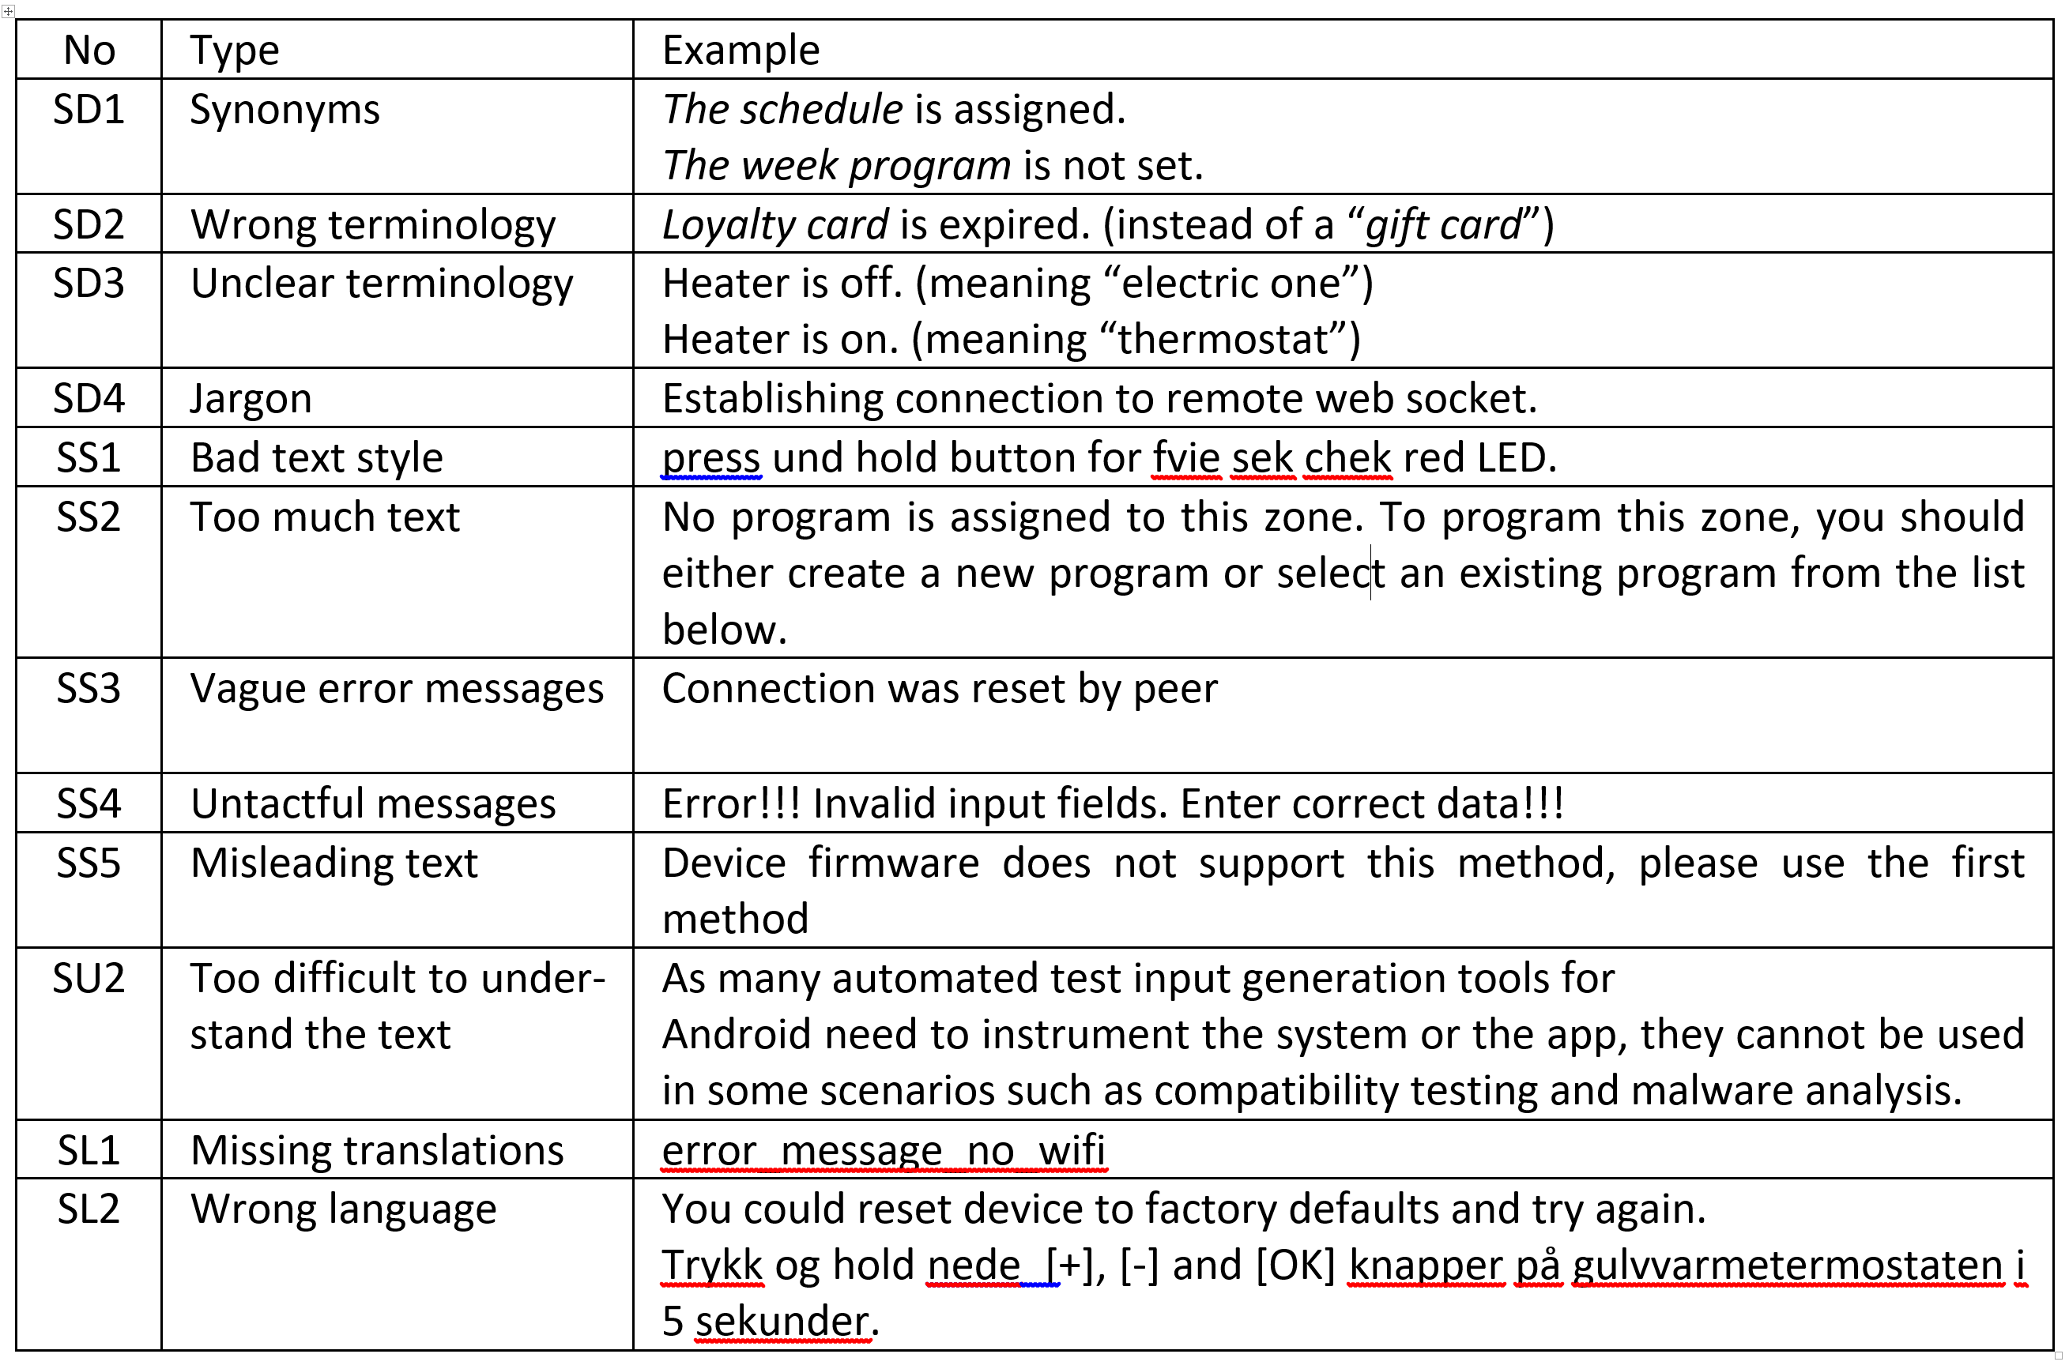
Classification of the user-interface text defects
Text semantics defects

Slide 22
Detection of the defects
Sources:
Screenshots
Application window texts
Application texts
Process:
Generate app execution paths.
Run on many devices.
Take screenshots.
Analyse all screenshots

Slide 23
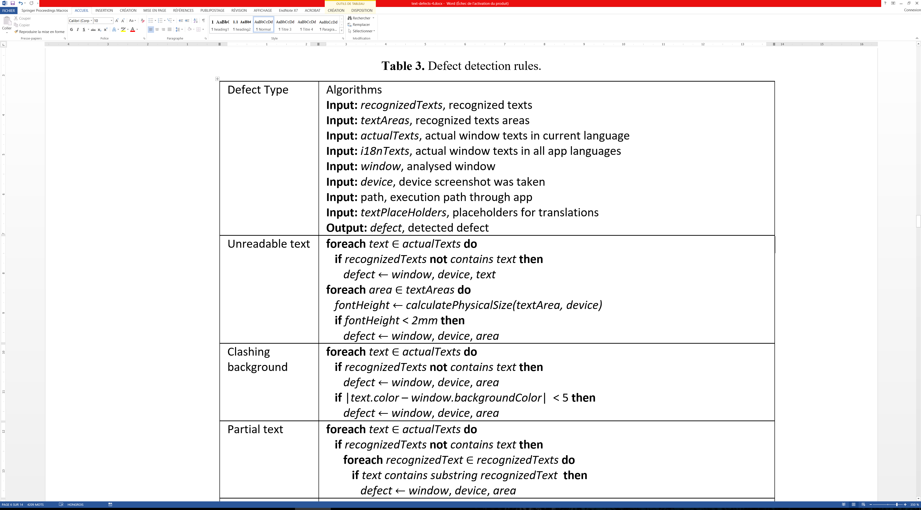
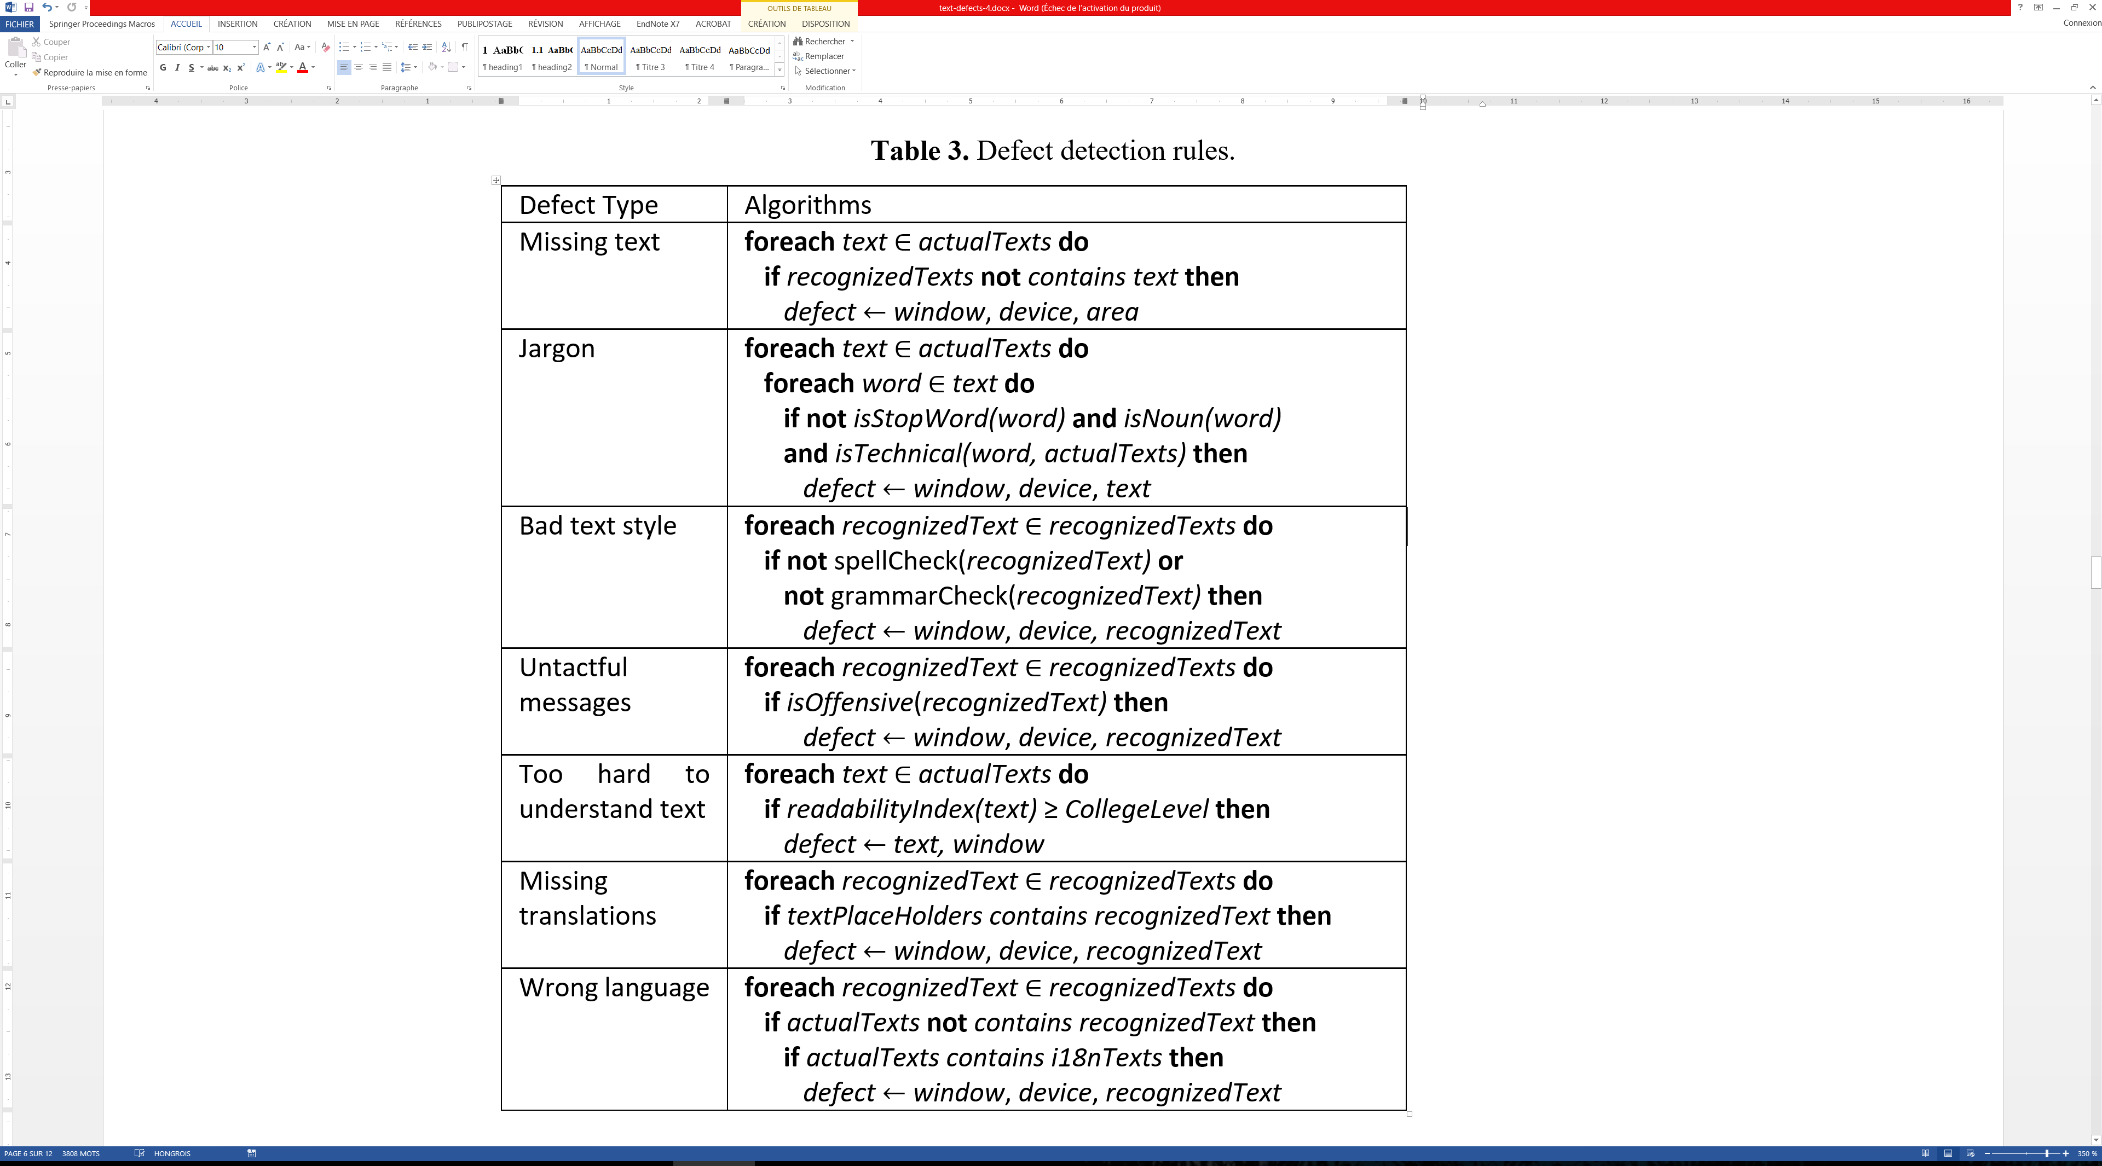
Detection rules

Slide 24
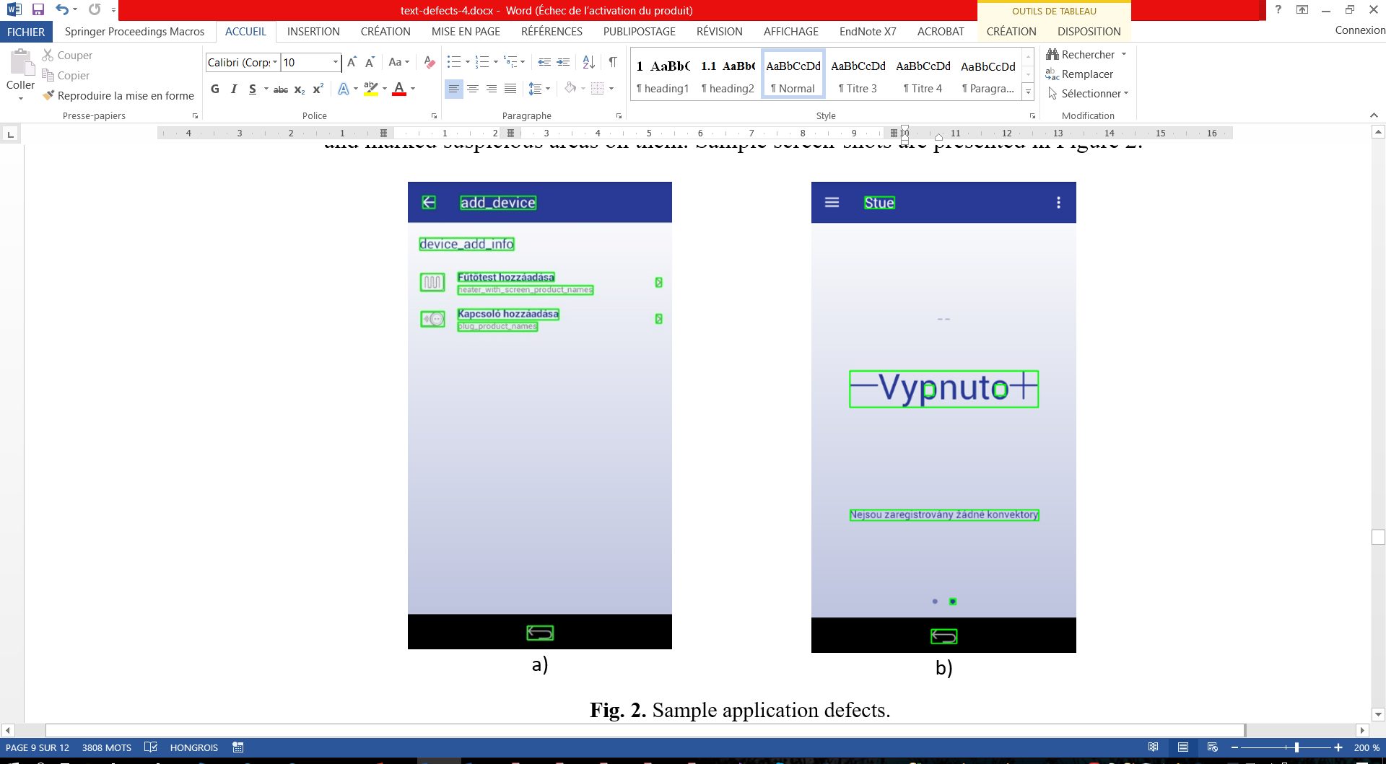
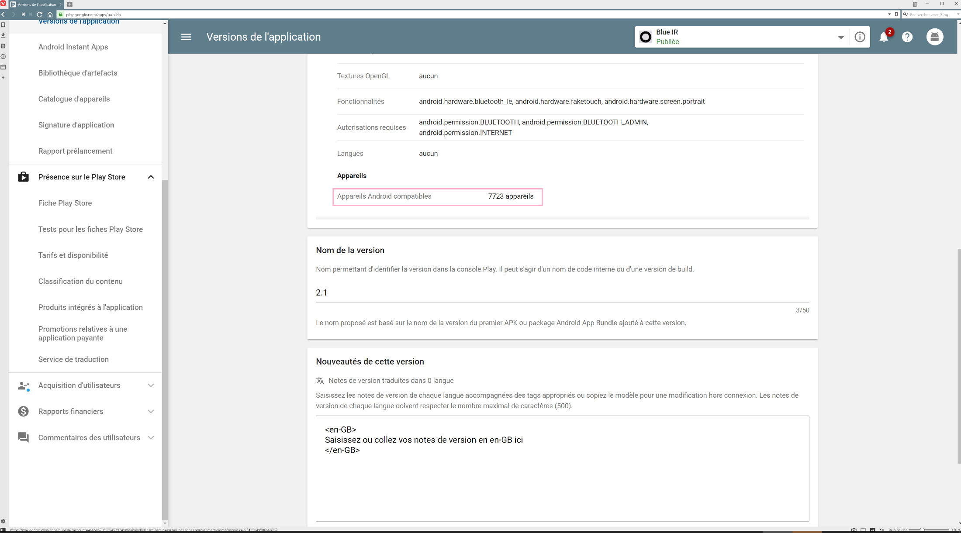
Testing example
One small app as showcase
Multilanguage support
iPhone and Android apps
Multiple devices support

Slide 25
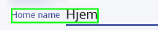
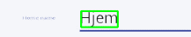
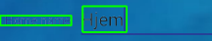
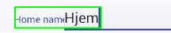
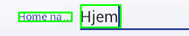
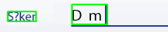

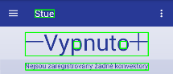
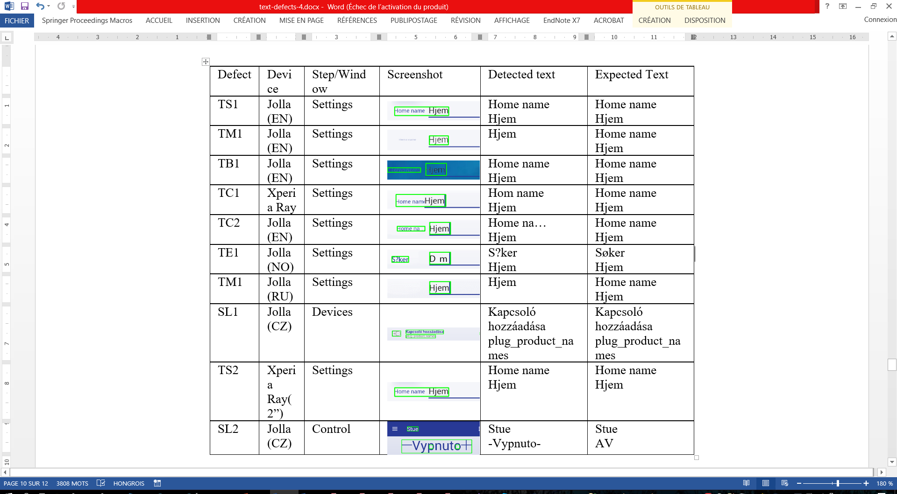
Testing results

Slide 26
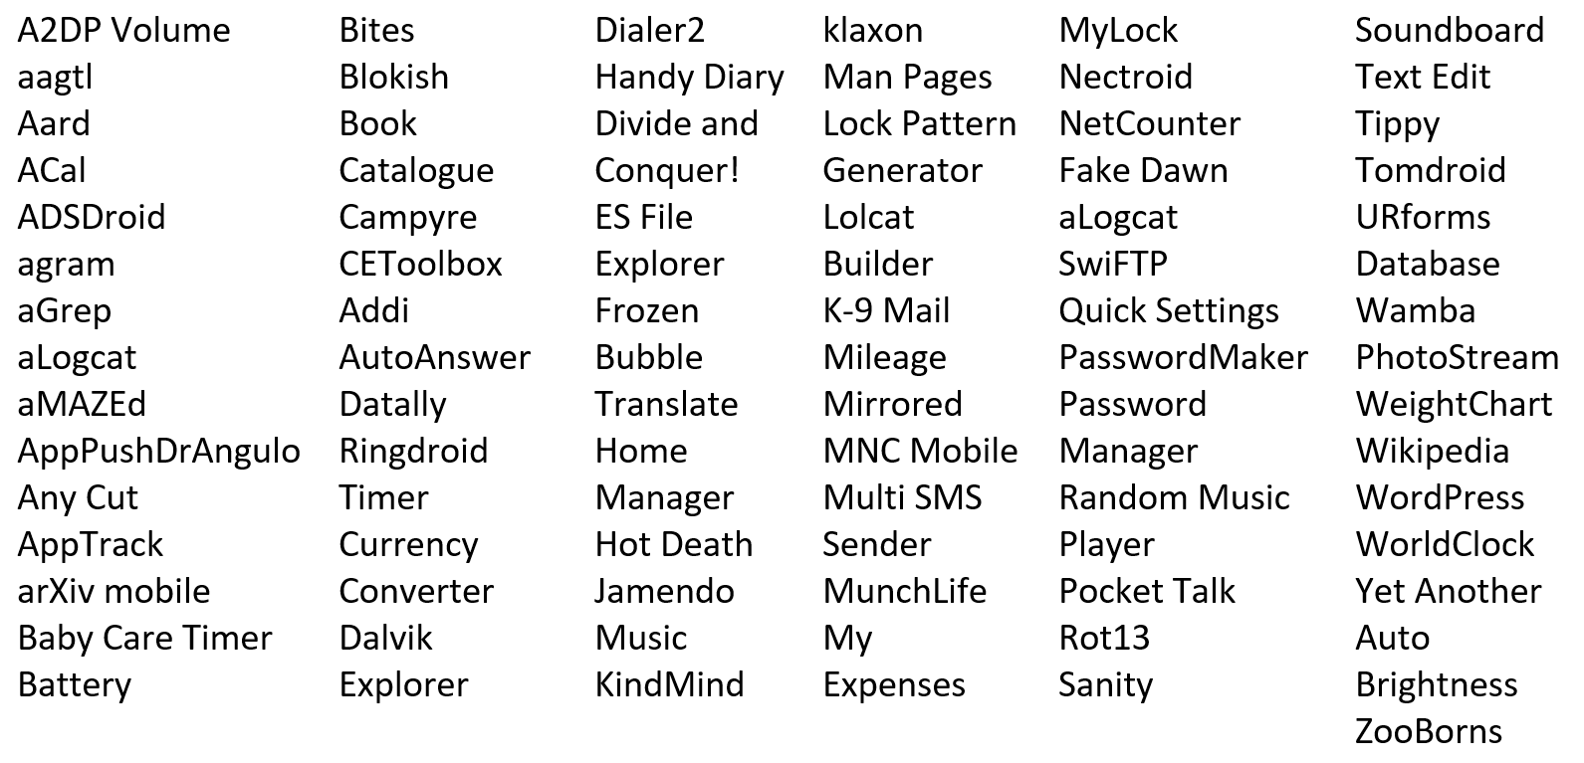
Some experiments – benchmarks (~80 apps)

Slide 27
Some findings
Readability, Style:
Attention: for uninstalling Sanity you must revoke those privileges (otherwise the uninstall processo will fail).
getUseWebViewBackgroundForOverscrollBackground : false
If the disclaimer of warranty and limitation of liability provided above cannot be given local legal effect according to their terms, reviewing courts shall apply local law that most closely approximates an absolute waiver of all civil liability in connection with the Program, unless a warranty or assumption of liability accompanies a copy of the Program in return for a fee.
I/cr_LibraryLoader( 3840): Expected native library version number "51.0.2704.90", actual native library version number "51.0.2704.90“
Automatically remember last used media volume on disconnect
The app needs access to your contects to tell who messages are from when reading messages.
Offensive:
Error: invalid name!
Translations:
Naujovinkite, kad vertimas neprisijungus būtų geresnis

Slide 28
“Conclusions” and further work
The method is similar to an automated static analysis.
Provided text presentation and content defects categories and defect types.
Identification of the troubling user interface locations.
The main drawback is long testing time (for images).
What is the optimal subset of mobile devices for testing?
Apps actually do have declared defects and it is possible to find them:
Apps translated automatically.
Partially translated apps.
Spelling.
Hard to understand texts.

Slide 29
Questions
Any bugs in presentation?

